Slide 1

Fraud Detection Using Machine Learning In UPI
Darshan kalekar 19015
Aditya kumbhar 19049

Slide 2
Index
Decision Table for UPI Fraud Detection
Traceability Matrix for UPI Fraud Detection System
Test Cases for UPI Fraud Detection System

Slide 3
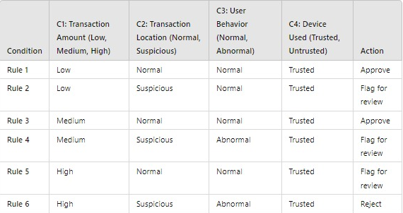
Decision Table for UPI Fraud Detection

Slide 4
Explanation of Conditions and Actions
1. Transaction Amount: Low: Below a predefined threshold. Medium: Within a moderate range. High: Above a certain threshold.
2. Transaction Location: Normal: Transactions made from known locations for the user. Suspicious: Unfamiliar locations, especially if they are far from previous locations
3. User Behavior: Normal: Behavior consistent with past transactions (frequency, amount). Abnormal: Significant deviations from typical behavior.
4. Device Used: Trusted: Devices that the user has previously used without issues. Untrusted: New or unrecognized devices.
Approve: The transaction is approved based on low risk.
Flag for review: The transaction should be investigated further.
Reject: The transaction is denied due to high risk.

Slide 5
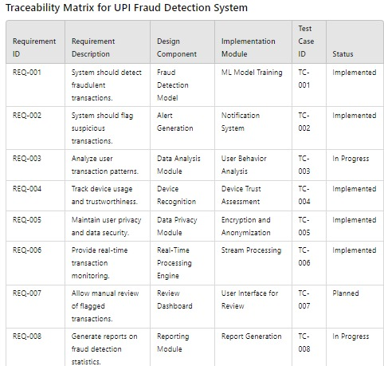
Traceability Matrix for UPI Fraud Detection System

Slide 6
Explanation of Columns and Usage
1. Requirement ID: A unique identifier for each requirement.
2. Requirement Description: A brief description of what the system should achieve.
3. Design Component The high-level design component that addresses the requirement.
4. Implementation Module: The specific module or part of the system that implements the requirement.
5. Test Case ID: The identifier for the corresponding test case that verifies the requirement.
Track the progress of development and testing.
Ensure that every requirement is addressed in the design and implementation phases.
Facilitate communication among team members regarding the status of various components.

Slide 7
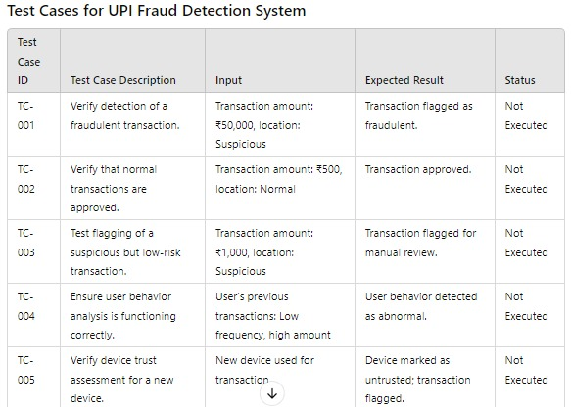
Test Cases for UPI Fraud Detection System

Slide 8
Explanation of Columns and Usage
1. Test Case ID: Unique identifier for each test case.
2. Test Case Description: Brief description of what the test case will validate.
3. Input: The specific inputs or conditions for the test case.
4. Expected Result: What the expected outcome should be if the test passes.
5. Status: Current status of the test case (e.g., Not Executed, Passed, Failed).
These test cases can be executed during different phases of the software development lifecycle, including unit testing, integration testing, and uThese test cases can be executed during different phases of the software development lifecycle, including unit testing, integration testing

